Slide 1


Sandia Insights – Maintenance Manager’s Working Group
August 28, 2024
Dr. Patrick Carlson - Sandia National Lab
SAND2024-10951PE

Slide 2

Presenter
Dr. Patrick Carlson
PhD graduate in Human-Computer Interaction (HCI) from Iowa State University
Worked at Sandia National Labs as a Data Scientist since 2017
Leads the Sandia Data Sciences Community of Practice (CoP)
Interested in the technical aspects of Data Science such as data engineering, programming, analysis, modeling, machine learning, productionization, ml-ops, data-ops, and more

Slide 3




Why Sandia Insights
Reduce duplication and rework
Faster turnaround time
Data Scientists and Data Engineers
Data Governance
Leadership
Rapid access to data
Robust tooling
Common environment with libraries preinstalled
HPC and model training
Data security
Centralized access controls
Central data catalog management
Data-driven decision making

Slide 4
Vision for Sandia Insights
Empower Data Scientists and Analysts through easy access to vetted enterprise datasets
Secure and document data through Data Governance and a data catalog
Productionize and operationalize models, use data-ops and ml-ops practices
Build out a pipeline and best practices for the entire data-lifecycle
Focus on people and methods, not specific tools

Slide 5

Data Lifecycle

Slide 6
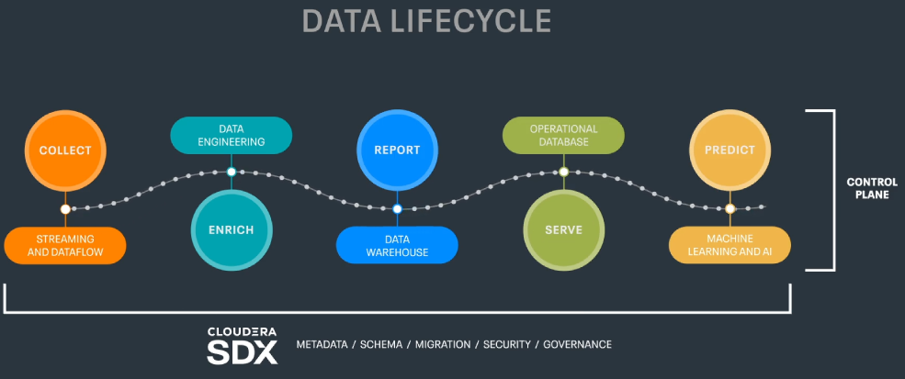

Slide 7
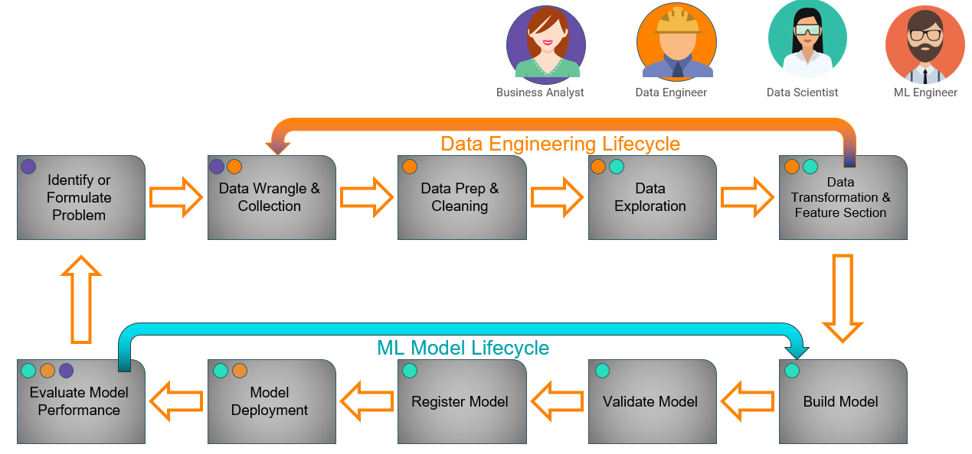
Advanced Analytics Data Lifecycle
Notes:
People and expertise matter more than IT tooling and software. The delineation of roles and expertise as part of the data lifecycle is exceedingly important. Don’t assume hiring a Data Scientist will mean they can do everything well unless you hire a unicorn! This is a feedback loop.

Slide 8
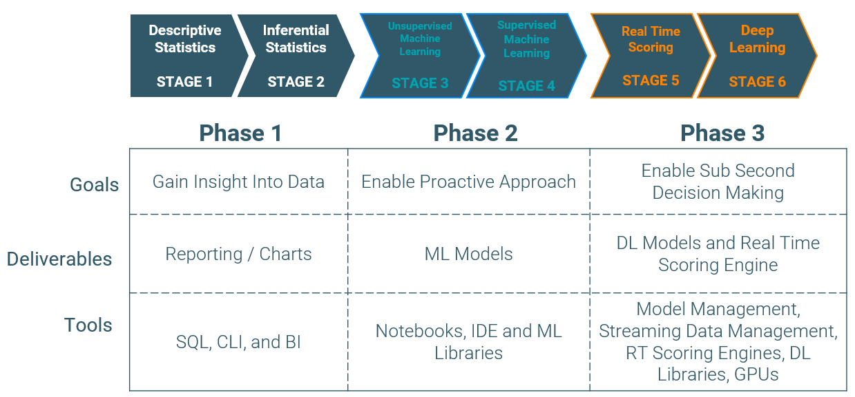
Progression of Enterprise Data Science Practices

Slide 9
Machine Learning Ops (MLops)
Reproducibility of analytics and machine learning models
Move from “it ran once on my desktop” to “it runs all day at scale for the enterprise”
The productionization of machine learning and other AI related models

Slide 10
Impact of Automated Data Pipelines
Rapid access to current data enables reporting and analytics access to quickly changing datasets or tables
Providing robust tooling to augment and not interfere with existing data pipelines such as ETL
More agile development of future data pipelines
Ensure end-to-end security and governance throughout entire pipeline
Provide leadership with real-time dashboards and decision-making opportunities

Slide 11

Cloudera
Enable data-ops
Distributed data lake storage, 150 TB – HDFS
Data engineering, data transformation, Massively Parallel Processing (MPP) via Spark
Databases and optimization engines – Hive, Hbase, Impala, Iceberg
Security, access controls, tagging, and data catalog – Ranger, Atlas
Enable ml-ops
Cloudera Machine Learning (CML)
Productionize machine learning training and inference
Containerized notebook environments – Jupyter, R, Python, etc.
Support Data Scientists
Experiment tracking, hyperparameter tuning, and versioning of models

Slide 12
Lessons Learned and Best Practices
Challenges | Actions
Culture of “ownership” of data | Implement Data Governance
Pockets of Data Scientists around the lab | Data Sciences Community of Practice (CoP)
Lack of leadership support and direction | Get a Chief Data Office (CDO) or Deputy Chief Data Officer
Lack of documentation around data | Implement a data catalog
Data architecture is old | Understand architectural paradigms: ETL, ELT, data warehouse, data lake, lambda and kappa architectures, etc.
PRIORITIZE:
People
Processes
Architectures
Culture
Results
>
Tools
Software
One-Off Projects

Slide 13
Data Governance – a key component of Data Strategy
Purpose (why we exist)
Data Governance supports data-driven insights and access to data to enable Sandia’s innovation acceleration and modern engineering goals.
Vision (what we aspire to)
Sandia data is securely accessible, understood, and trusted and is used in a consistent, responsible, and meaningful manner to increase interoperability, ensure reliability, and inform decision making in our community.
Mission (what we do)
We design and implement policy and standards to enable data management and data sharing in order to support regulatory compliance, internal reporting & analytics, operational analytics for our business, data integration, and Artificial Intelligence (AI) and Machine Learning (ML) innovation and operations.

Slide 14
Focus Areas for Sandia Data Strategy & Governance
Enterprise Asset - Advocate the treatment of Sandia data as a corporate and government asset
Use Ready - Enable access and use of data for timely data driven decisions
Ease of Use - Support and develop mutually beneficial standards and practices to provide efficient and effective access to data
Support Community - Develop and socialize the responsibilities of Data Stewards
Taxonomy - Align the organizational strategies, digital transformation and data strategy, and data governance objectives between Enterprise and Mission Data Governance Efforts
Funding - Secure support and funding for agreed upon data strategy and data governance efforts
Communication - Provide organization-wide visibility to and flow-up / flow-down communication of data strategy and data governance efforts
Data Management Standards - Federate governance across program and mission areas

Slide 15
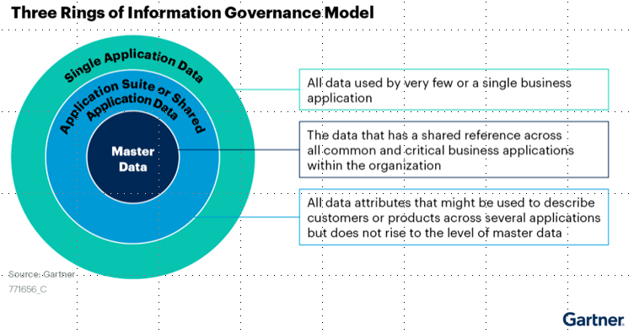
Degrees of Information Usefulness
Data has different levels of usefulness or importance
Sandia has two main groups of data, Corporate (NTESS) and Government Data (NNSA/DOE)
The more important the data, the more metadata is necessary to manage the data
Data Management includes collecting, organizing, protecting and storing data

Slide 16
Sandia Data Strategy & Governance Board Structure
Who do we talk to about the data?
Sandia Data Strategy and Governance Board
(Directors)
Executive Level
Sponsors the Governance program
Provides supporting leadership
Sets the direction and business strategy
Supports data and technology requirements
Incorporates broad laboratory strategy and responds to emergent needs
Enterprise / Mission Data Governance Board/s
(Senior Managers)
Strategic Level
Responsible for data governance process
Leads the governance program at tactical level within the domain or program
Mission areas must establish parallel structures here (like ND has already done)
Enterprise / Mission Data Governance Working Team/s
(Managers and Individual Contributors)
Execution / Tactical Level
Executes the Data Governance
activities and process for the domain
Works with identified Data Stewards
Creates the Data Architecture
Data Users

Slide 17
Data Integration Benefits cont.
Data Discovery
Gartner cites this is the #1 challenge for data management.
Provides one centralized security layer to manage and audit data usage.
Provide Lineage
Analysts are often asked to describe where data came from, data freshness, etc.
Forrester reports an average 364% ROI for implementing data catalogs primarily from saving analysts, data scientists and others as much as 80% of their time previously spent searching for data, how to request access, or who is domain expert.
Provides workflows, ticket integration, and policies through which to govern data.
Enables zero-trust through data categorization such as sensitivity labels.
Support Data Governance & Security
Trusting Data
Data Catalogs allow for interactions from data users to indicate their usefulness.
Authoritative Data Stewards can certify highly trustworthy data sources.
Lineage within a data catalog greatly facilitates this in a semi-automated fashion.

Slide 18
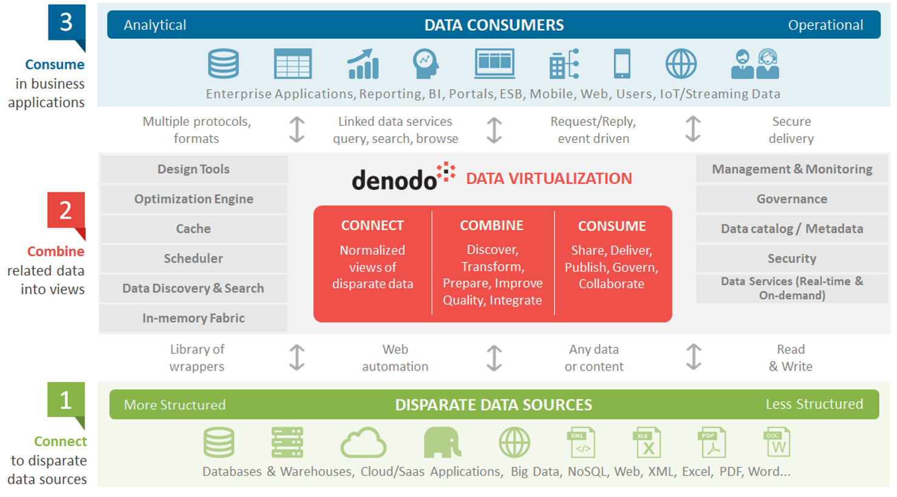
Denodo Data Virtualization
https://www.datavirtualizationblog.com/data-integration-made-easy-fast/denodo-architecture-2/
Notes:
The Denodo Data Catalog provides several strategies to help you discover your valuable data resources. You can:
Search by relevant terms in your catalog, using both the metadata of the data resources and their actual data as well.
Organize your data resources in categories and browse them.
Receive automatic recommendations of data assets according to your interactions.
Inspect which data assets are important for other users in your company.
Navigate through the views related to one view valuable for you.
You can check the fields that compose a data resource and study how they are built on the fields of other resources.
Statistics on how other users consume a data resource are available.
You can improve the descriptions from the Denodo servers.
You can add tags to them.
You can extend the metainformation about a data resource with whatever custom property you need.
In a collaborative way, users can support some data assets or discourage you from using them.
Use Role Based Access Control and Attribute Based Access Control to provide access to those authorized to see the data, just the metadata.

Slide 19
Generative AI
Very popular these days via tools like ChatGPT and DALL-E
Large Language Models (LLMs) provide a way of asking questions in natural language and getting a response
Possible through advancements in deep learning and huge quantities of data scraped from the internet
Multi-modal models are likely coming in the future to support text, images, video, sound, etc. all in one model

Slide 20
Sandia AI Chat
DEMO!

Slide 21
Future
Federated data access, cross-site data connectivity
Cross-site alignment on metadata, governance, tagging, etc.
AI and model governance and cataloging
Ties into software governance
Inventory of deployed models just as important as data!
Generative AI governance
Models will need access to large amounts of data
National Institute of Standards and Technology (NIST) AI Risk Management Framework (RMF)
Securing data, data pipelines into indexing, and model delivery all still require access controls and need-to-know (NTK)
Mature data governance, improve culture, decrease time to review and deliver data

Slide 22

Comments or Questions?
pcarlso@sandia.gov
https://carlsonp.github.io

